Slide 1
Comenius Project THE HERITAGE OF CULTURES AND TRADITIONS IN PLURALISTIC SOCIETY – RELIGIOUS TRADITIONS COM-13-PM-499-CJ-PL The number LLP Link: 2013-1-PL1-COM06-38866 2
Cluj-Napoca
1-6 June 2015

Slide 2
02 June- Tuesday - Project conference at school
Official opening of the partnership
meeting. (Festive Hall)
Movies about the country, region, city.
Folklore dance from Transylvania.
Workshop I : for teachers and students.
Visit to Botanical Garden “Alexandru
Borza” .

Slide 3
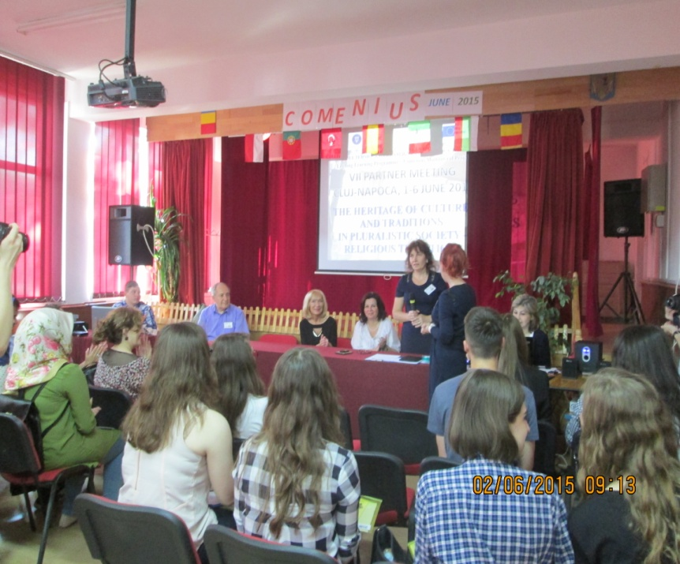
Official opening of the partnership meeting (Festive Hall)

Slide 4
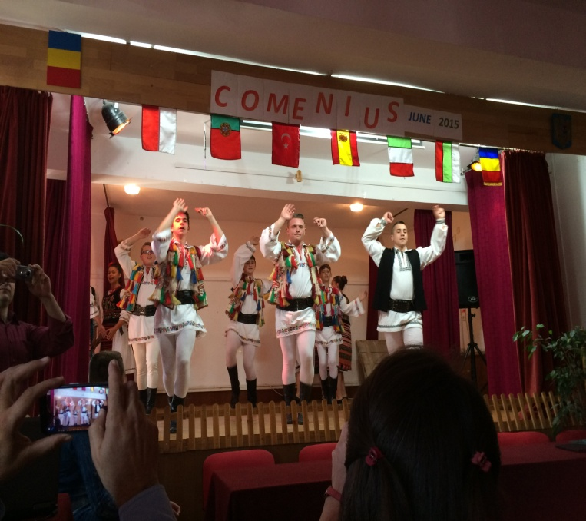
Folklore dance from Transylvania “Cununa Apusenilor”

Slide 5
Izvorașul

Slide 6
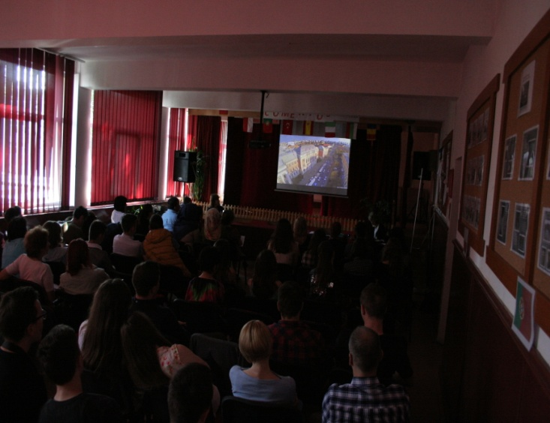
Who are we? Movies about the country, region, city

Slide 7
Workshop I: for students

Slide 8
Workshop I: for teachers

Slide 9
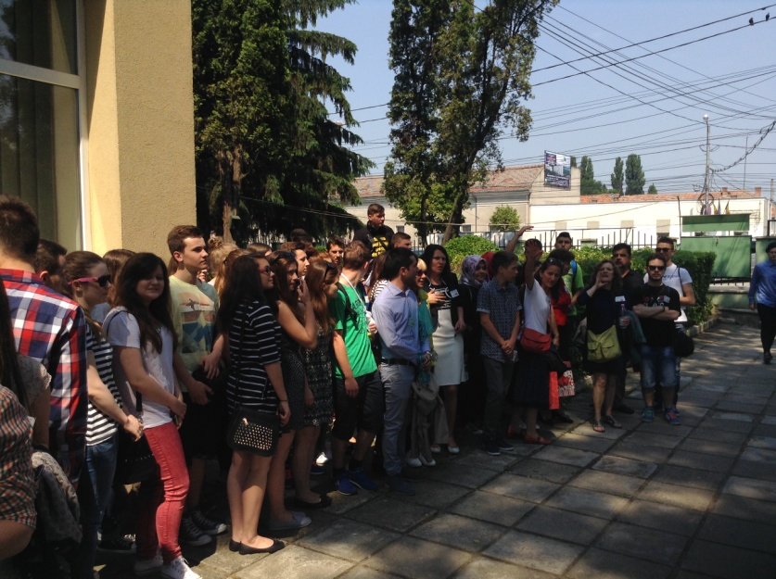
In the front of the school

Slide 10
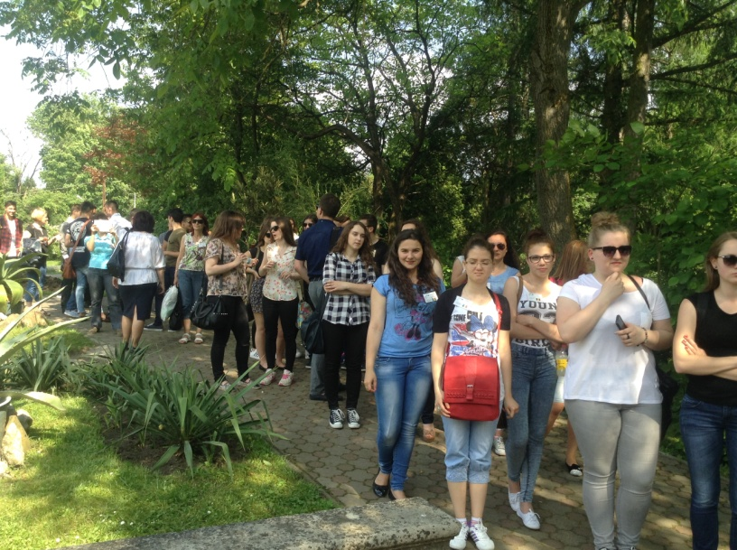
Visit to the Botanical Garden “Alexandru Borza”

Slide 11
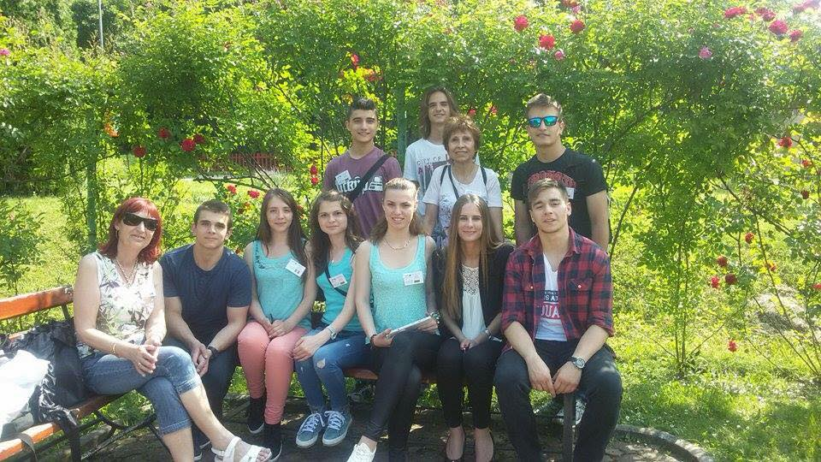

Slide 12
3 June- Wednesday - Project conference at school
Visiting school
Workshop II : Partner schools
presentation
Meeting with the City Hall officialties
Visiting the “Babes-Bolyai” University
City Tour

Slide 13
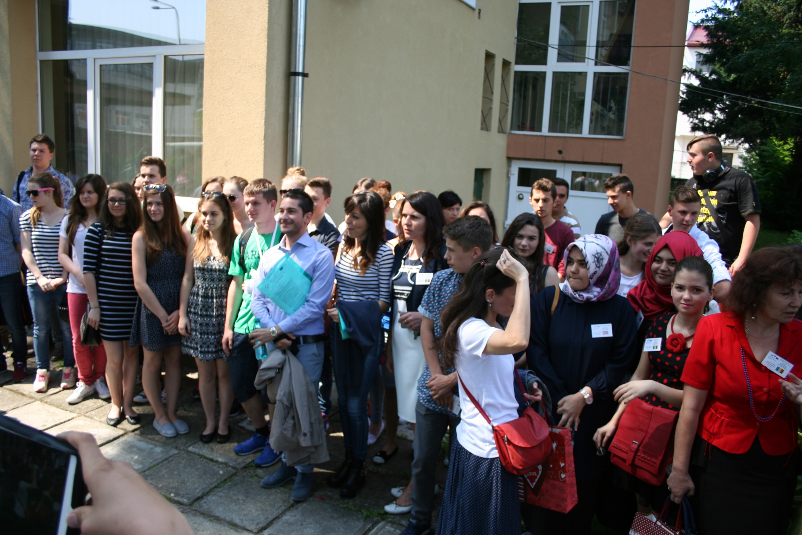
Visiting school

Slide 14
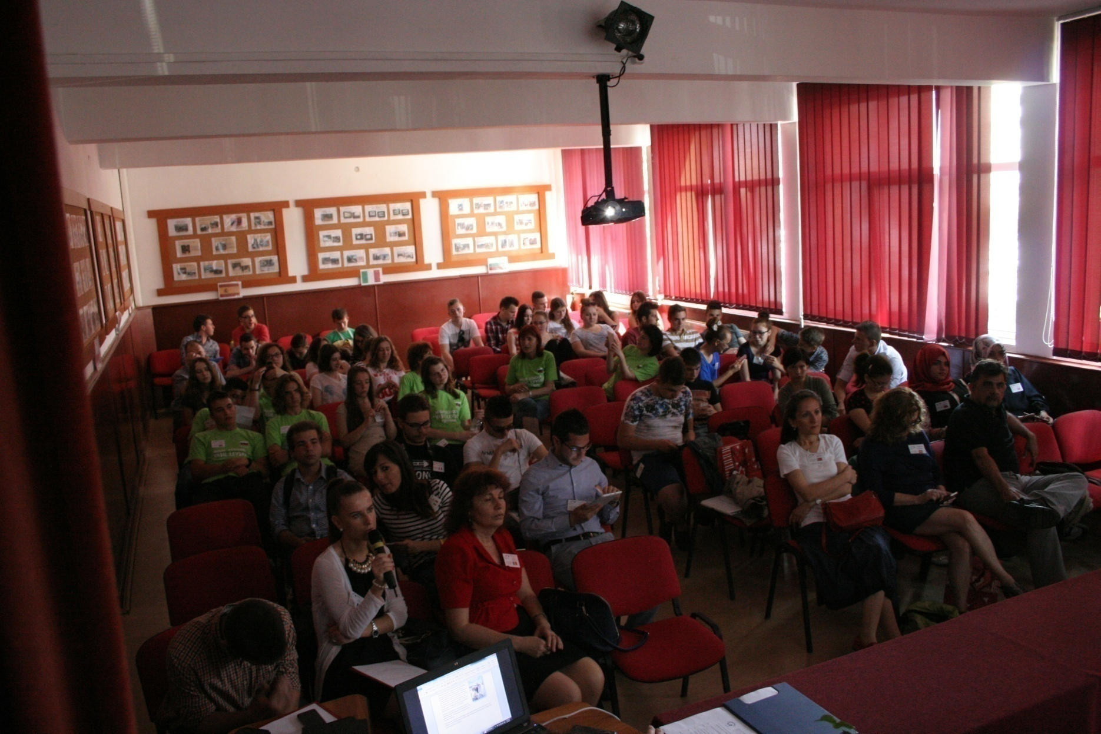
Workshop II :
Partner schools presentation

Slide 15
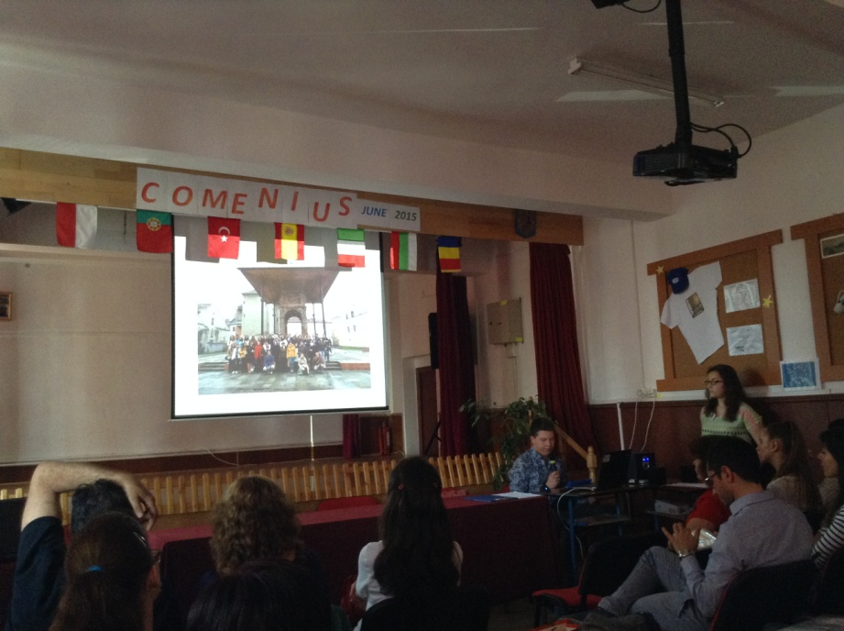
Poland

Slide 16
Turkey

Slide 17
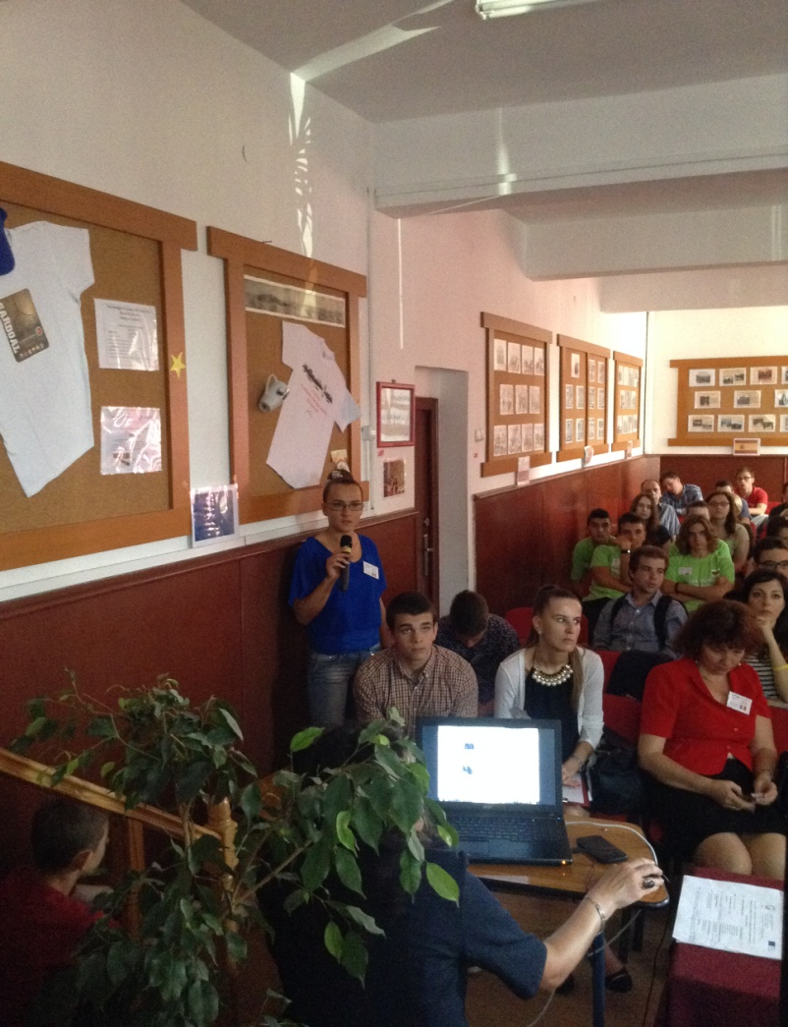
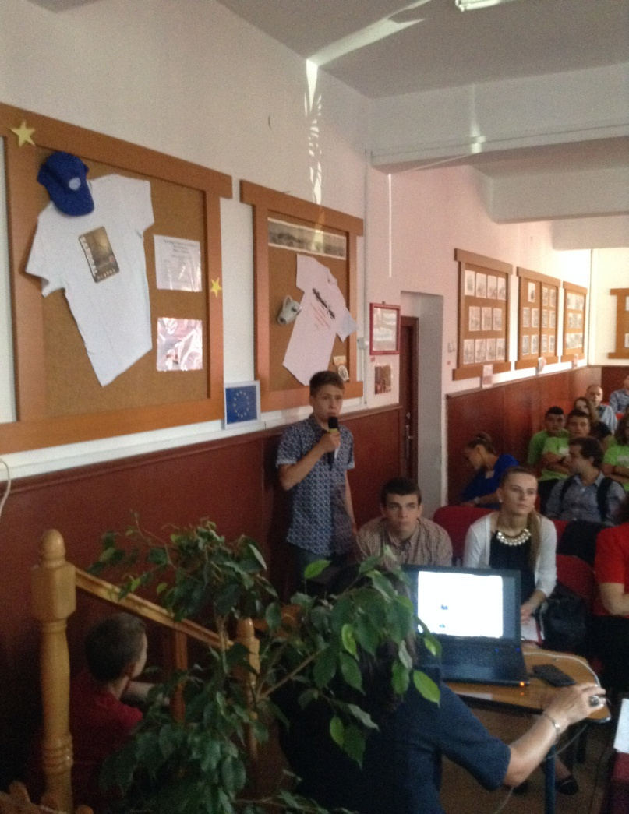
Romania

Slide 18
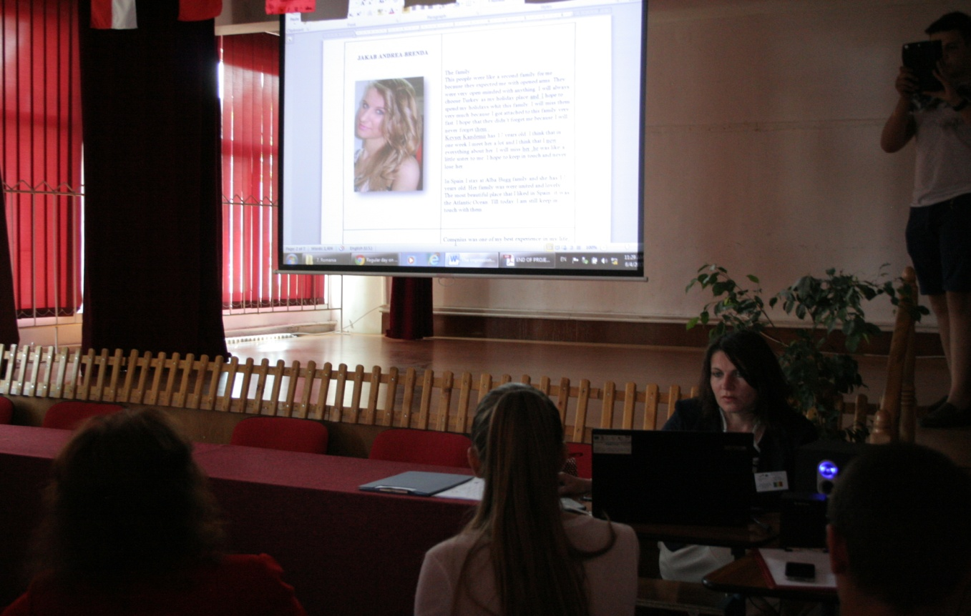

Slide 19
Portugal

Slide 20
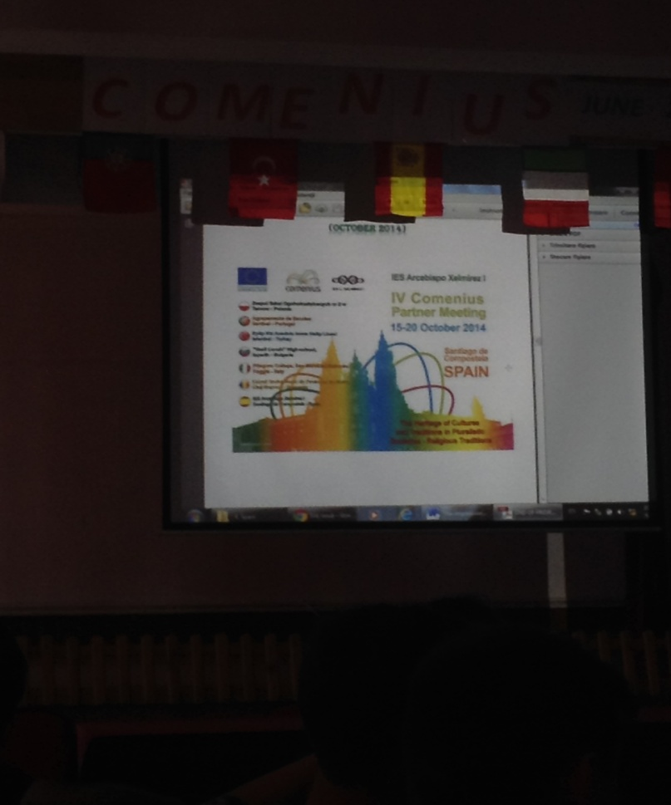
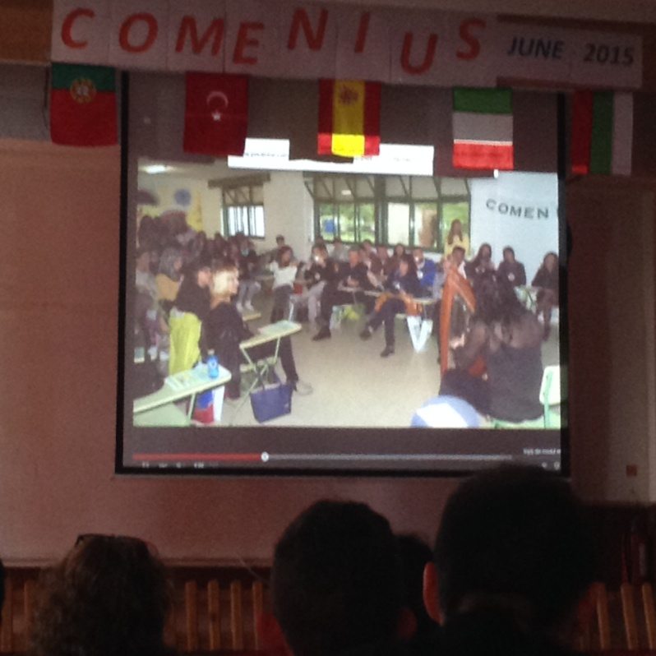
Spain

Slide 21
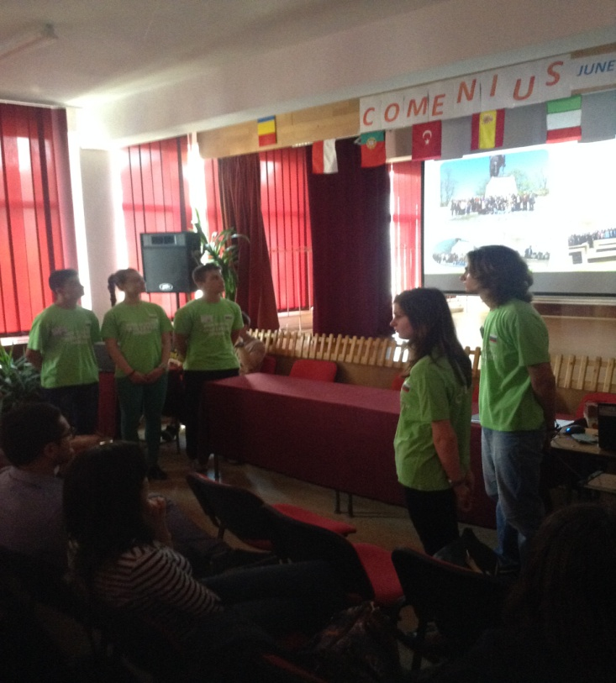
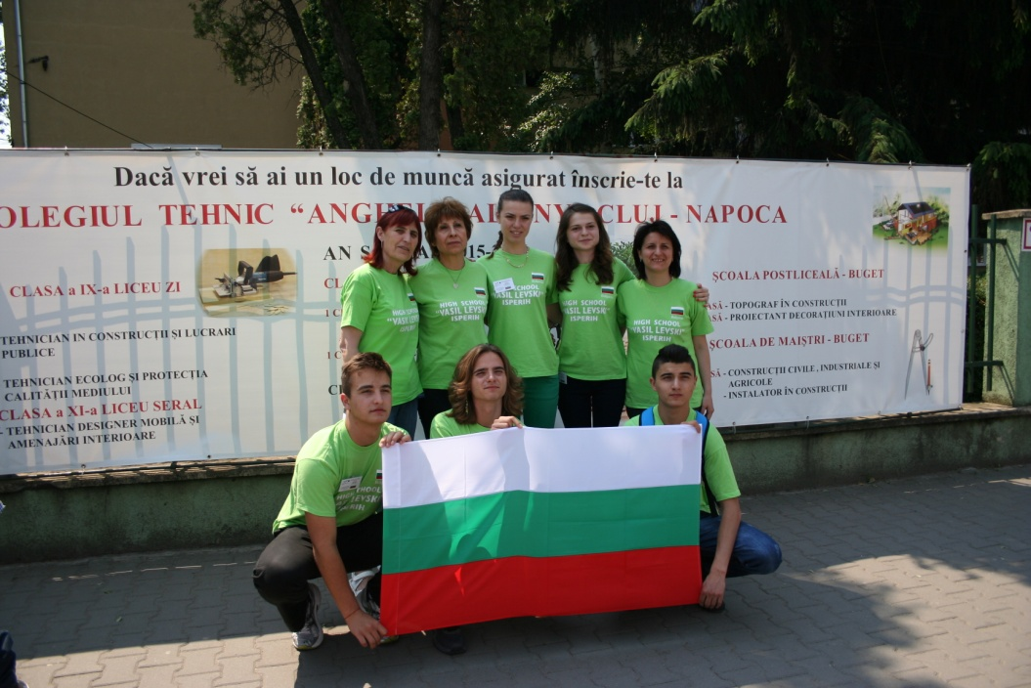
Bulgaria

Slide 22
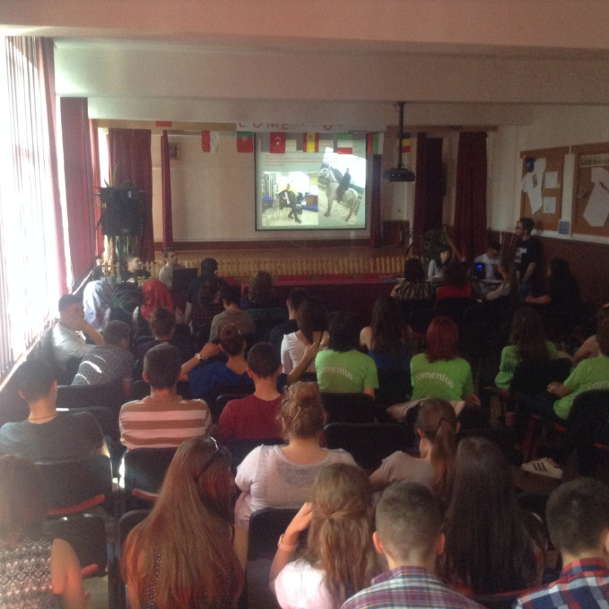
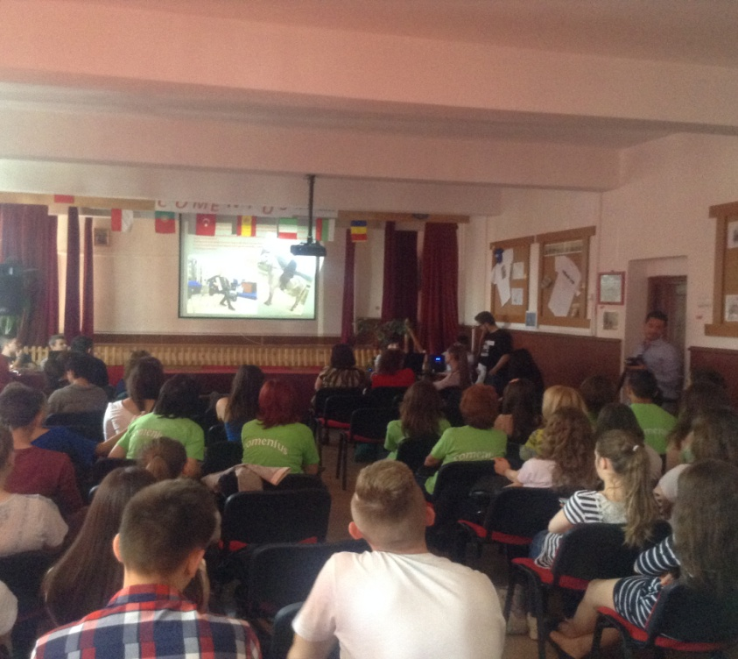
Italy

Slide 23
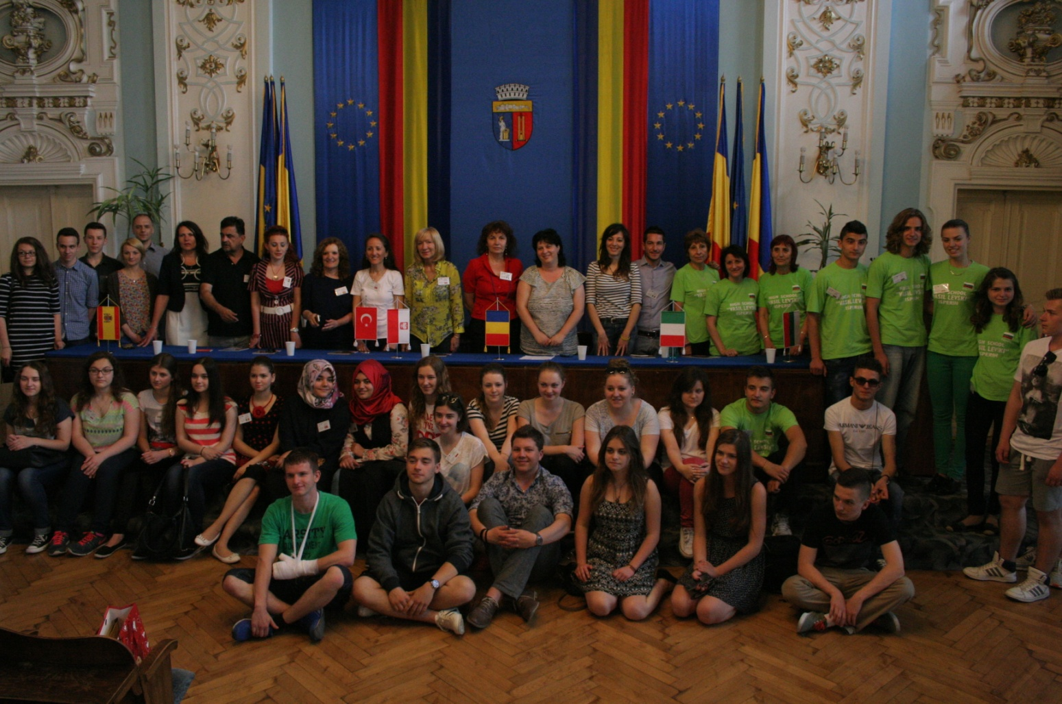
Meeting with the City Hall officialties

Slide 24
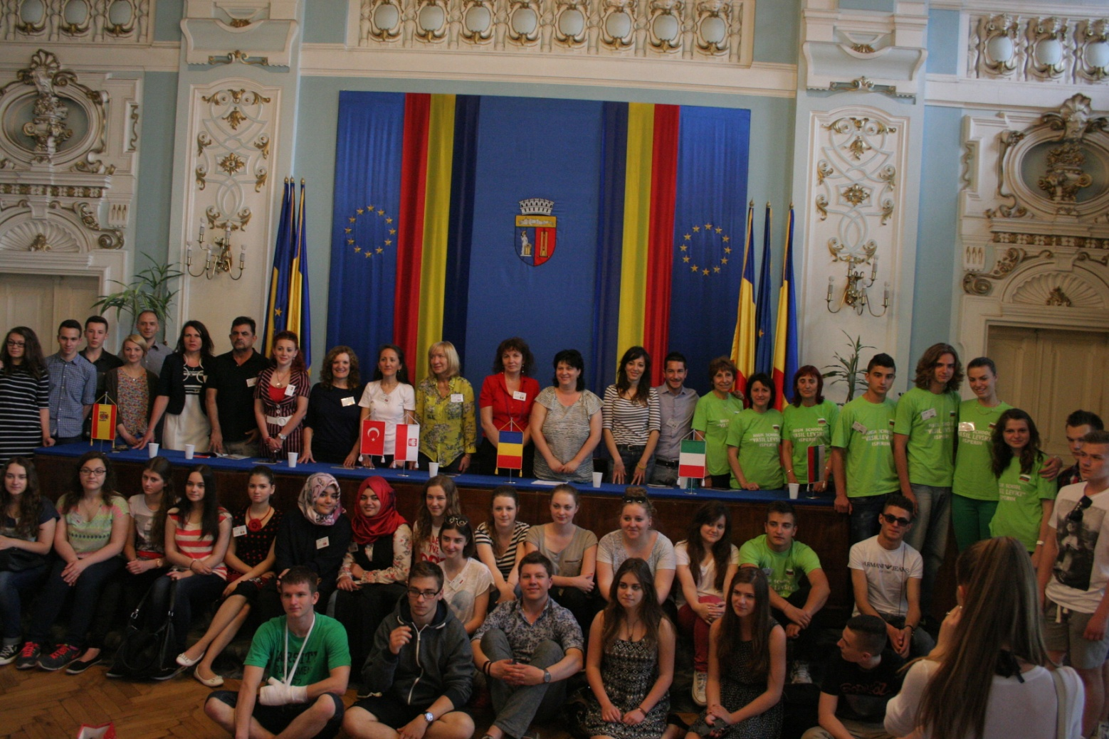

Slide 25
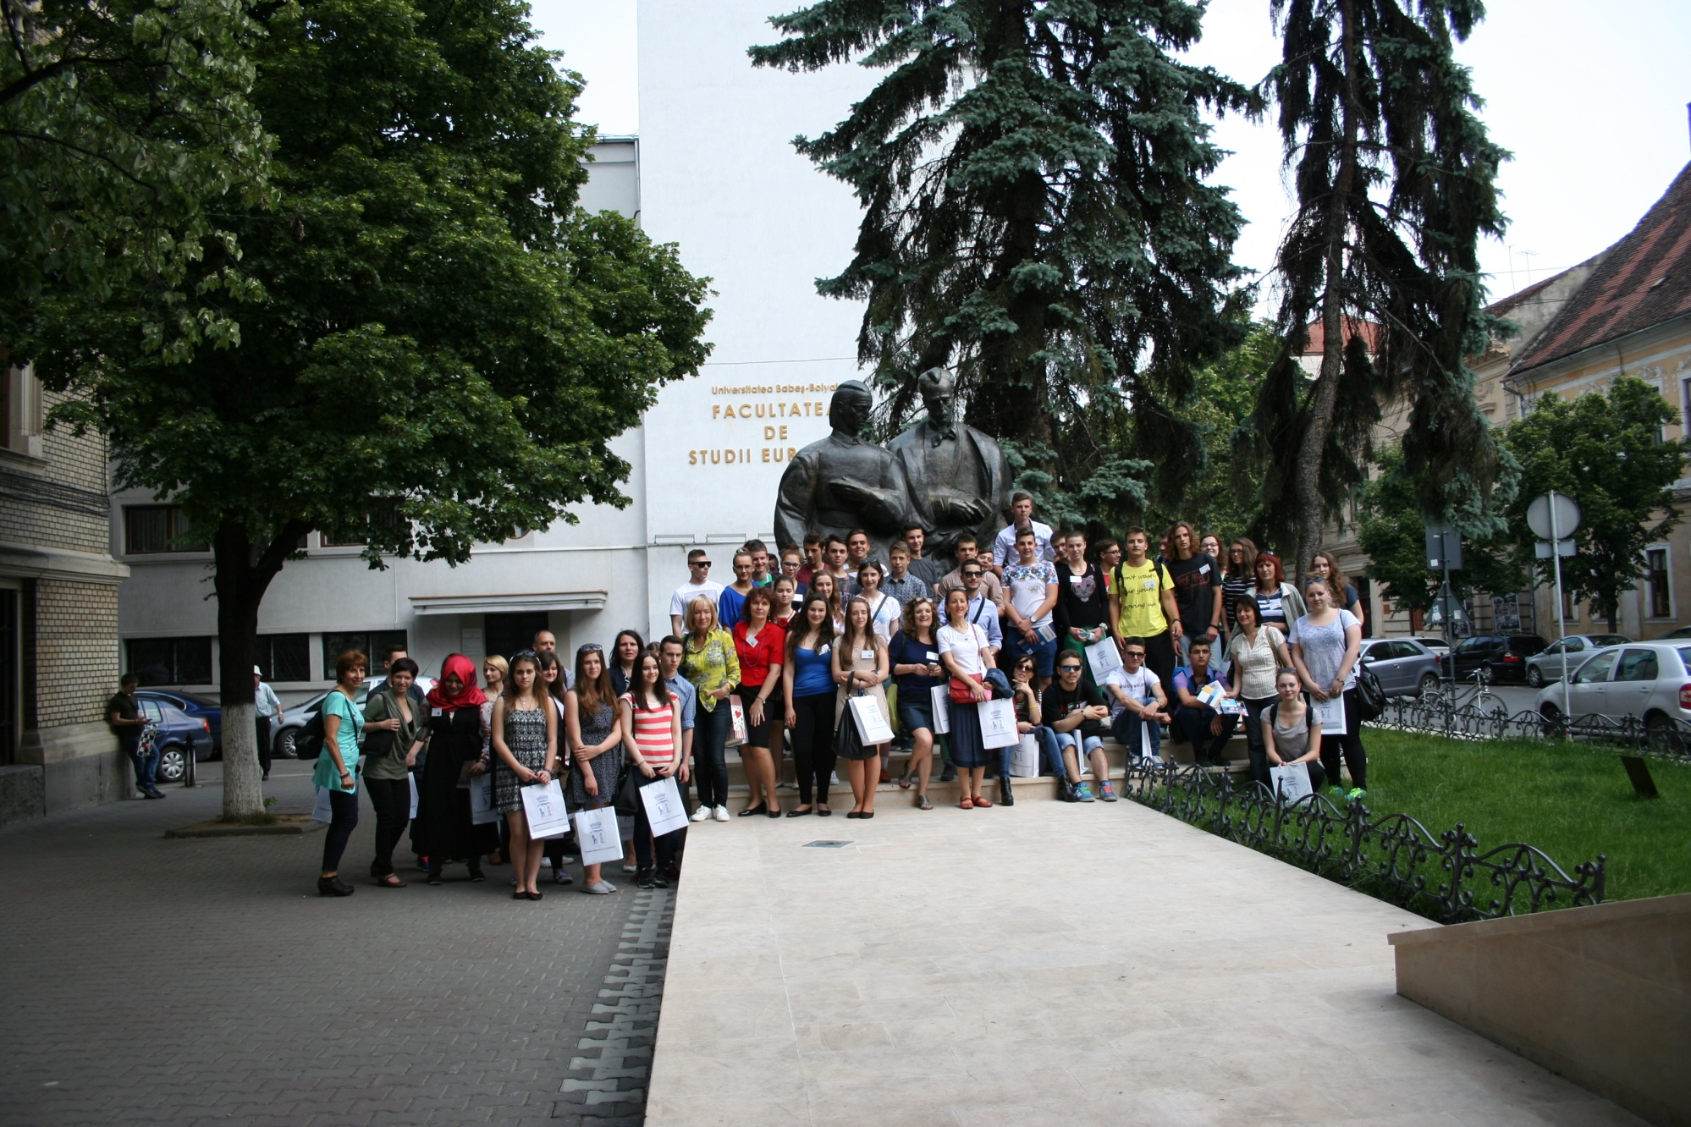
“Babeş-Bolyai” University

Slide 26
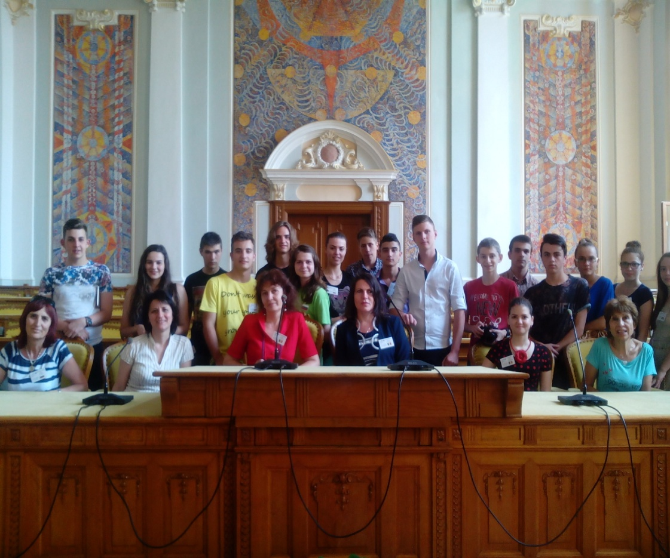
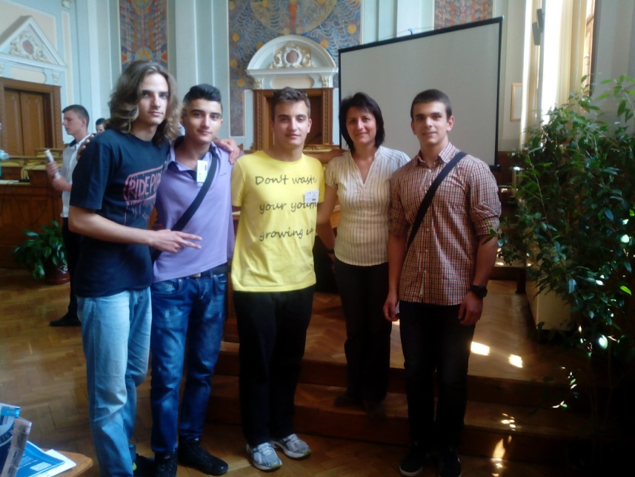
Aula Magna

Slide 27
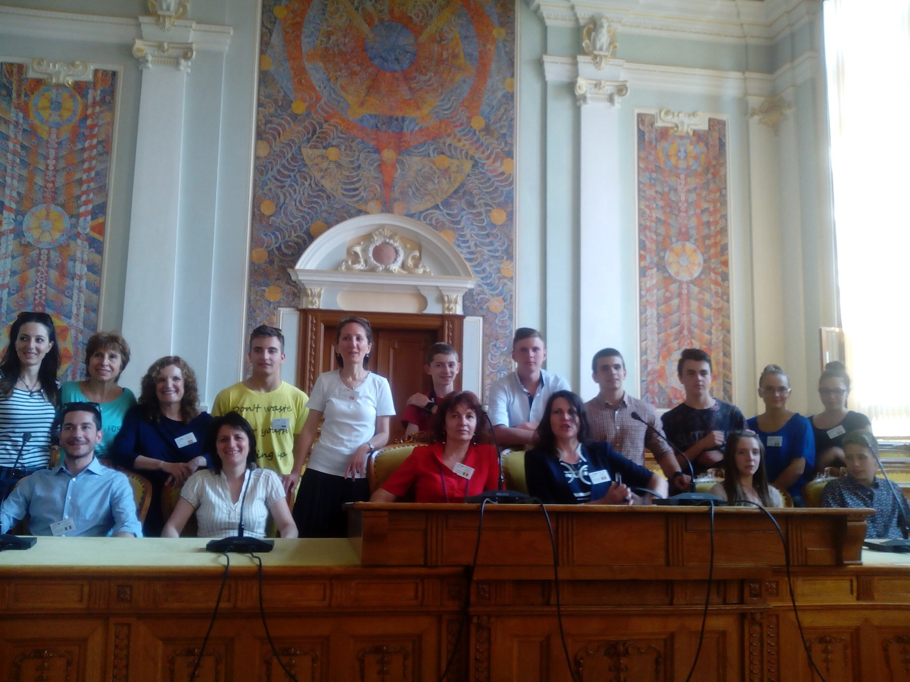
Aula Magna

Slide 28
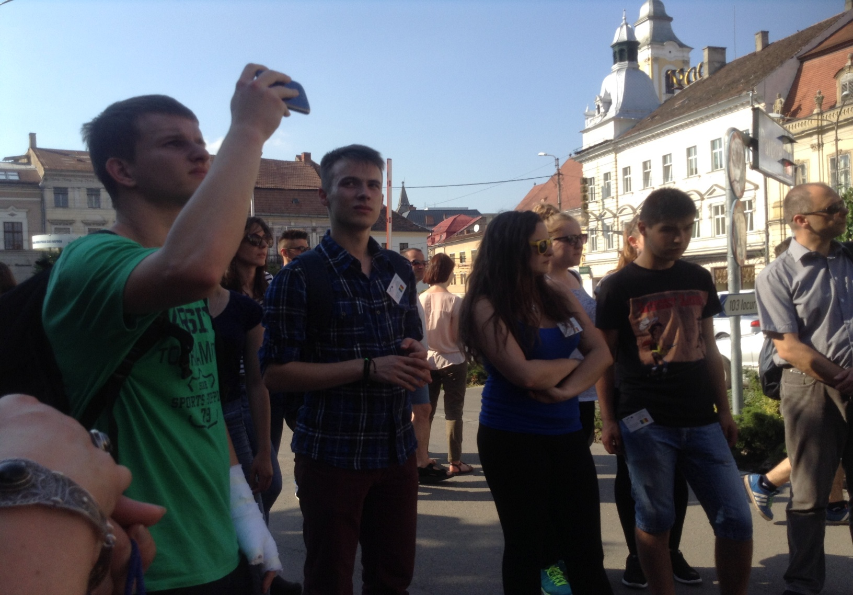
City tour

Slide 29
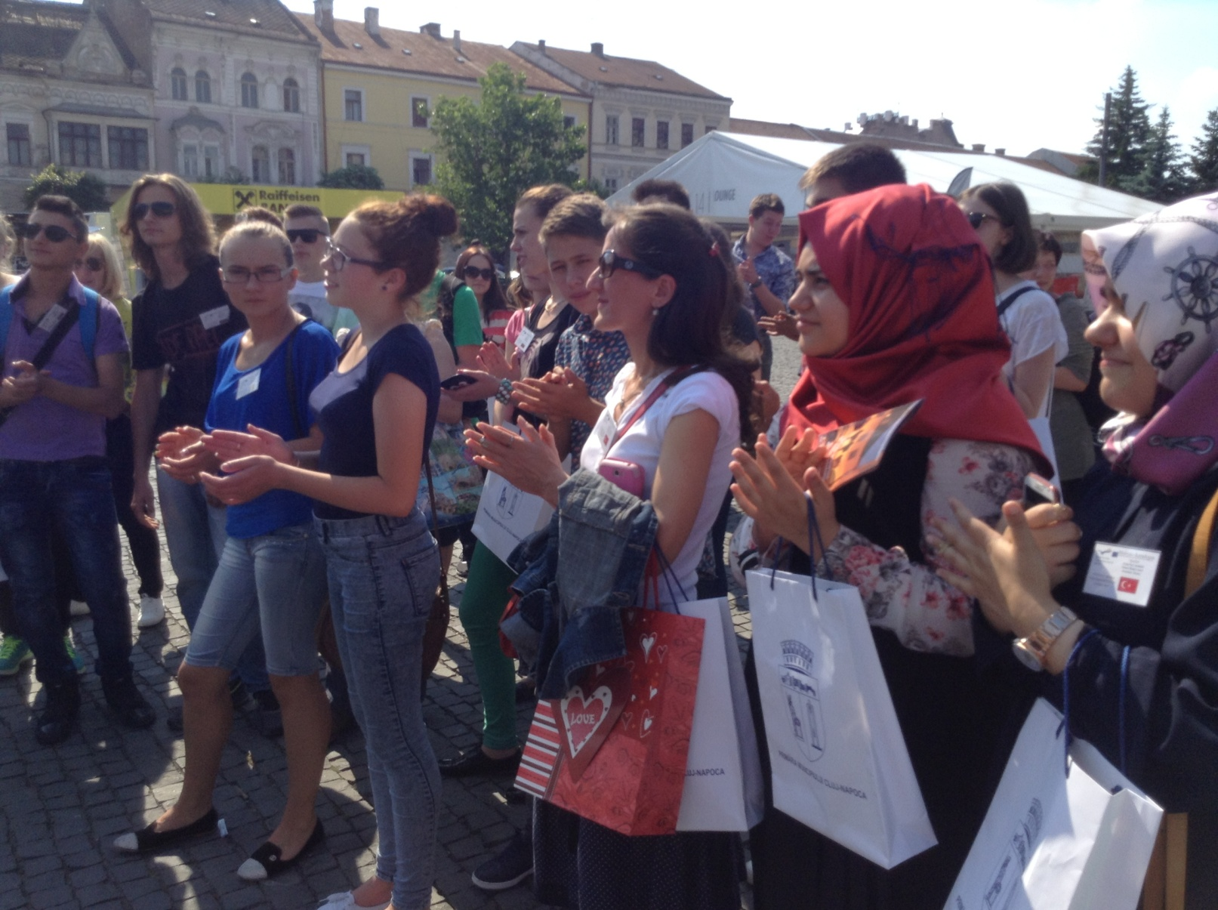
City tour

Slide 30
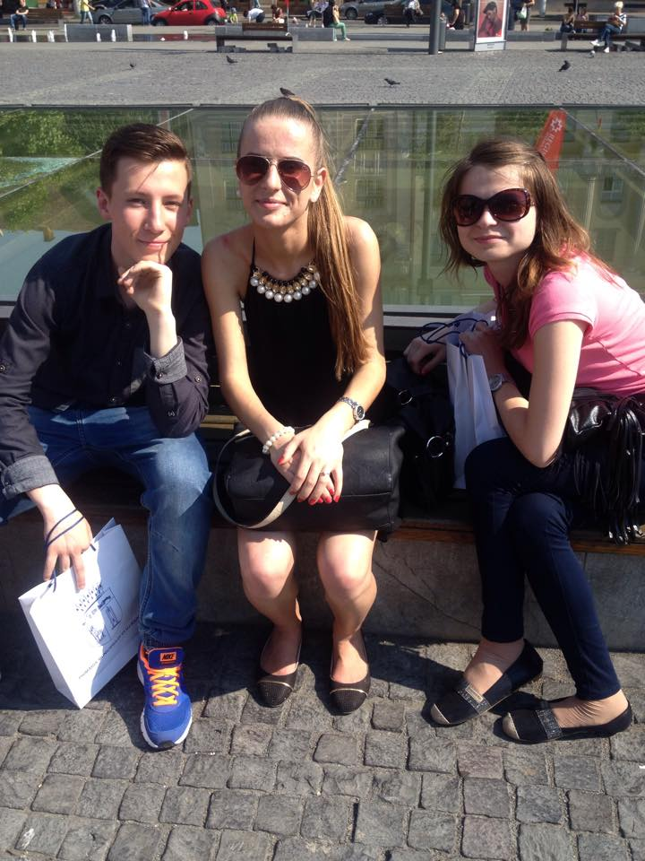

Slide 31
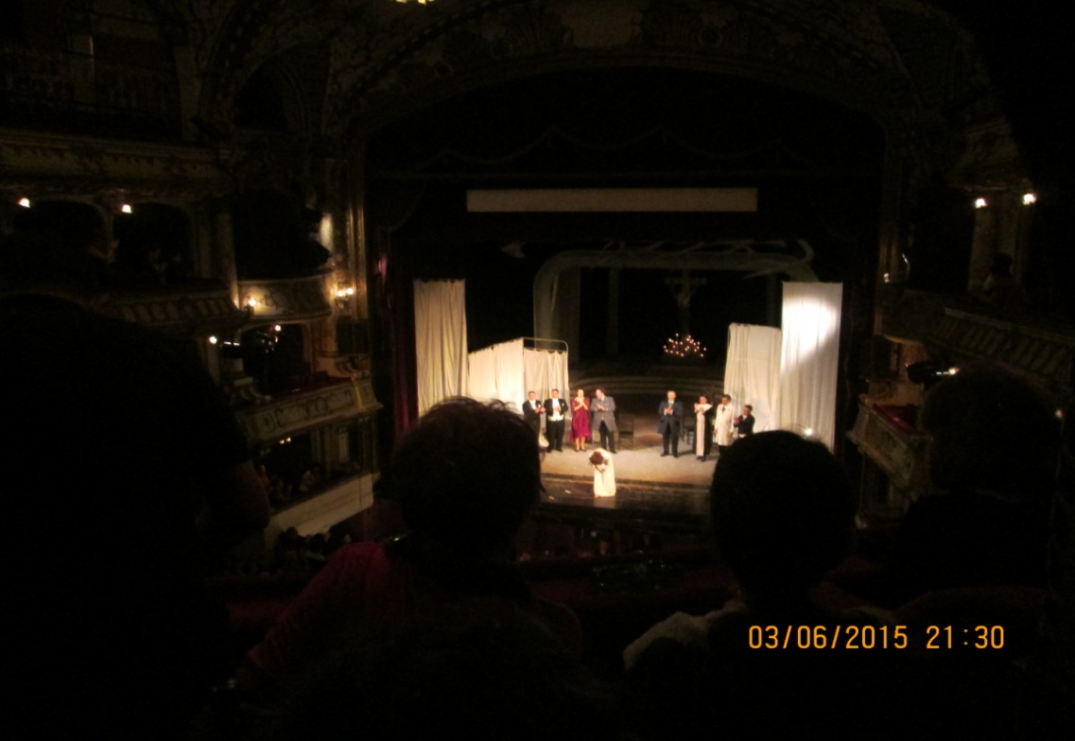
“Traviata”, Giuseppe Verdi

Slide 32
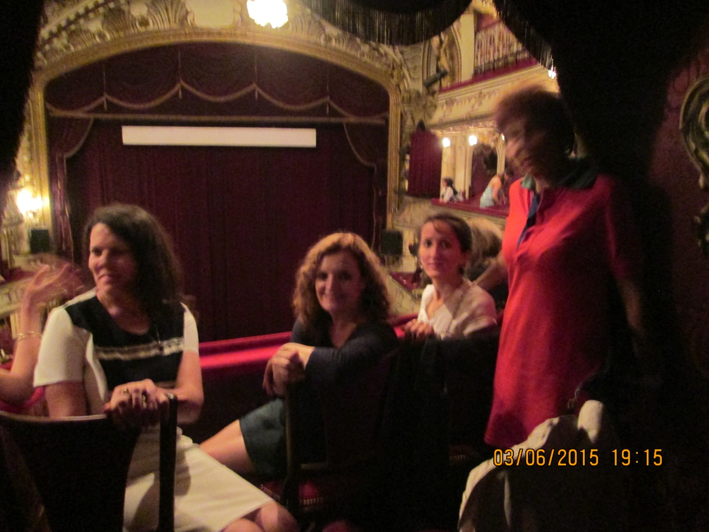
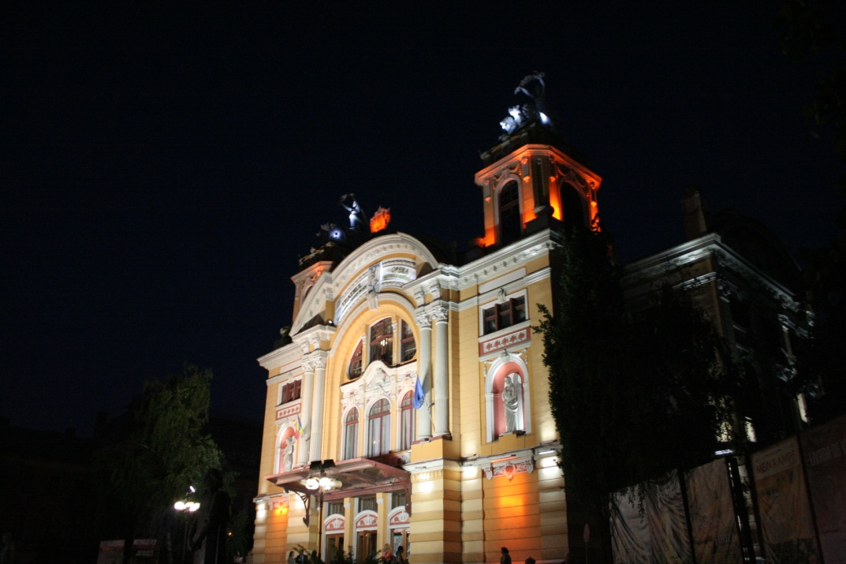
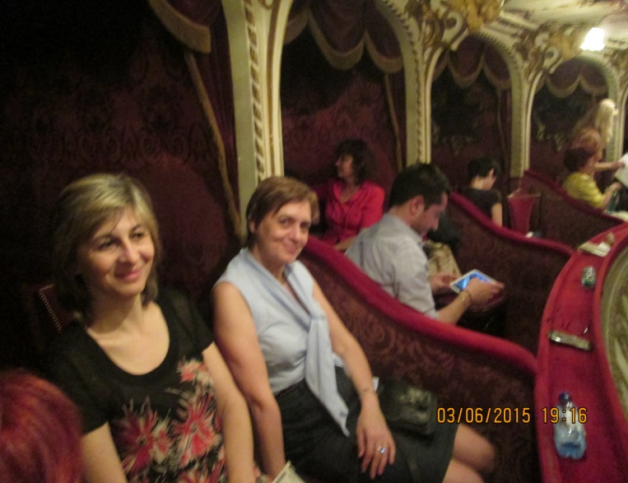
“Traviata”, Giuseppe Verdi

Slide 33
4 June- Thursday – Transylvania, the land beyond the forest
Study visits
Visit to Fagaras Castle
Visit to The Bran Castle
Visit to Sighisoara Fortress

Slide 34
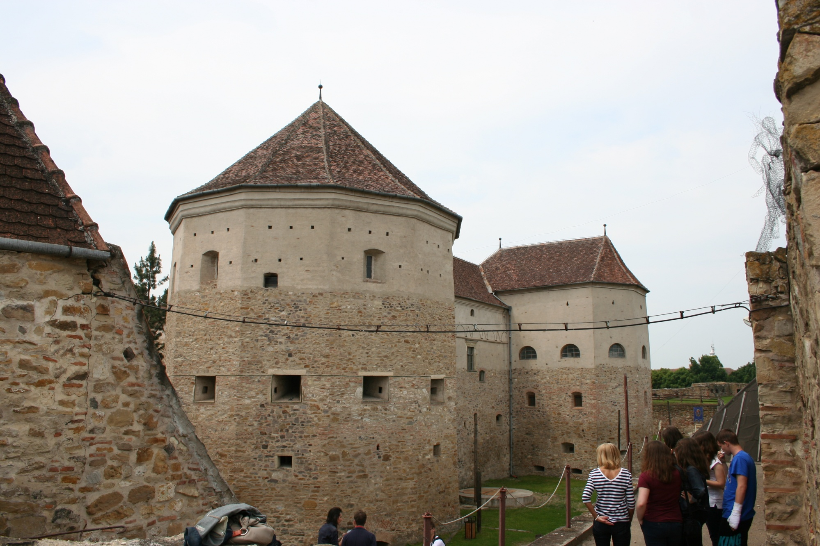
Făgăraş Castle

Slide 35
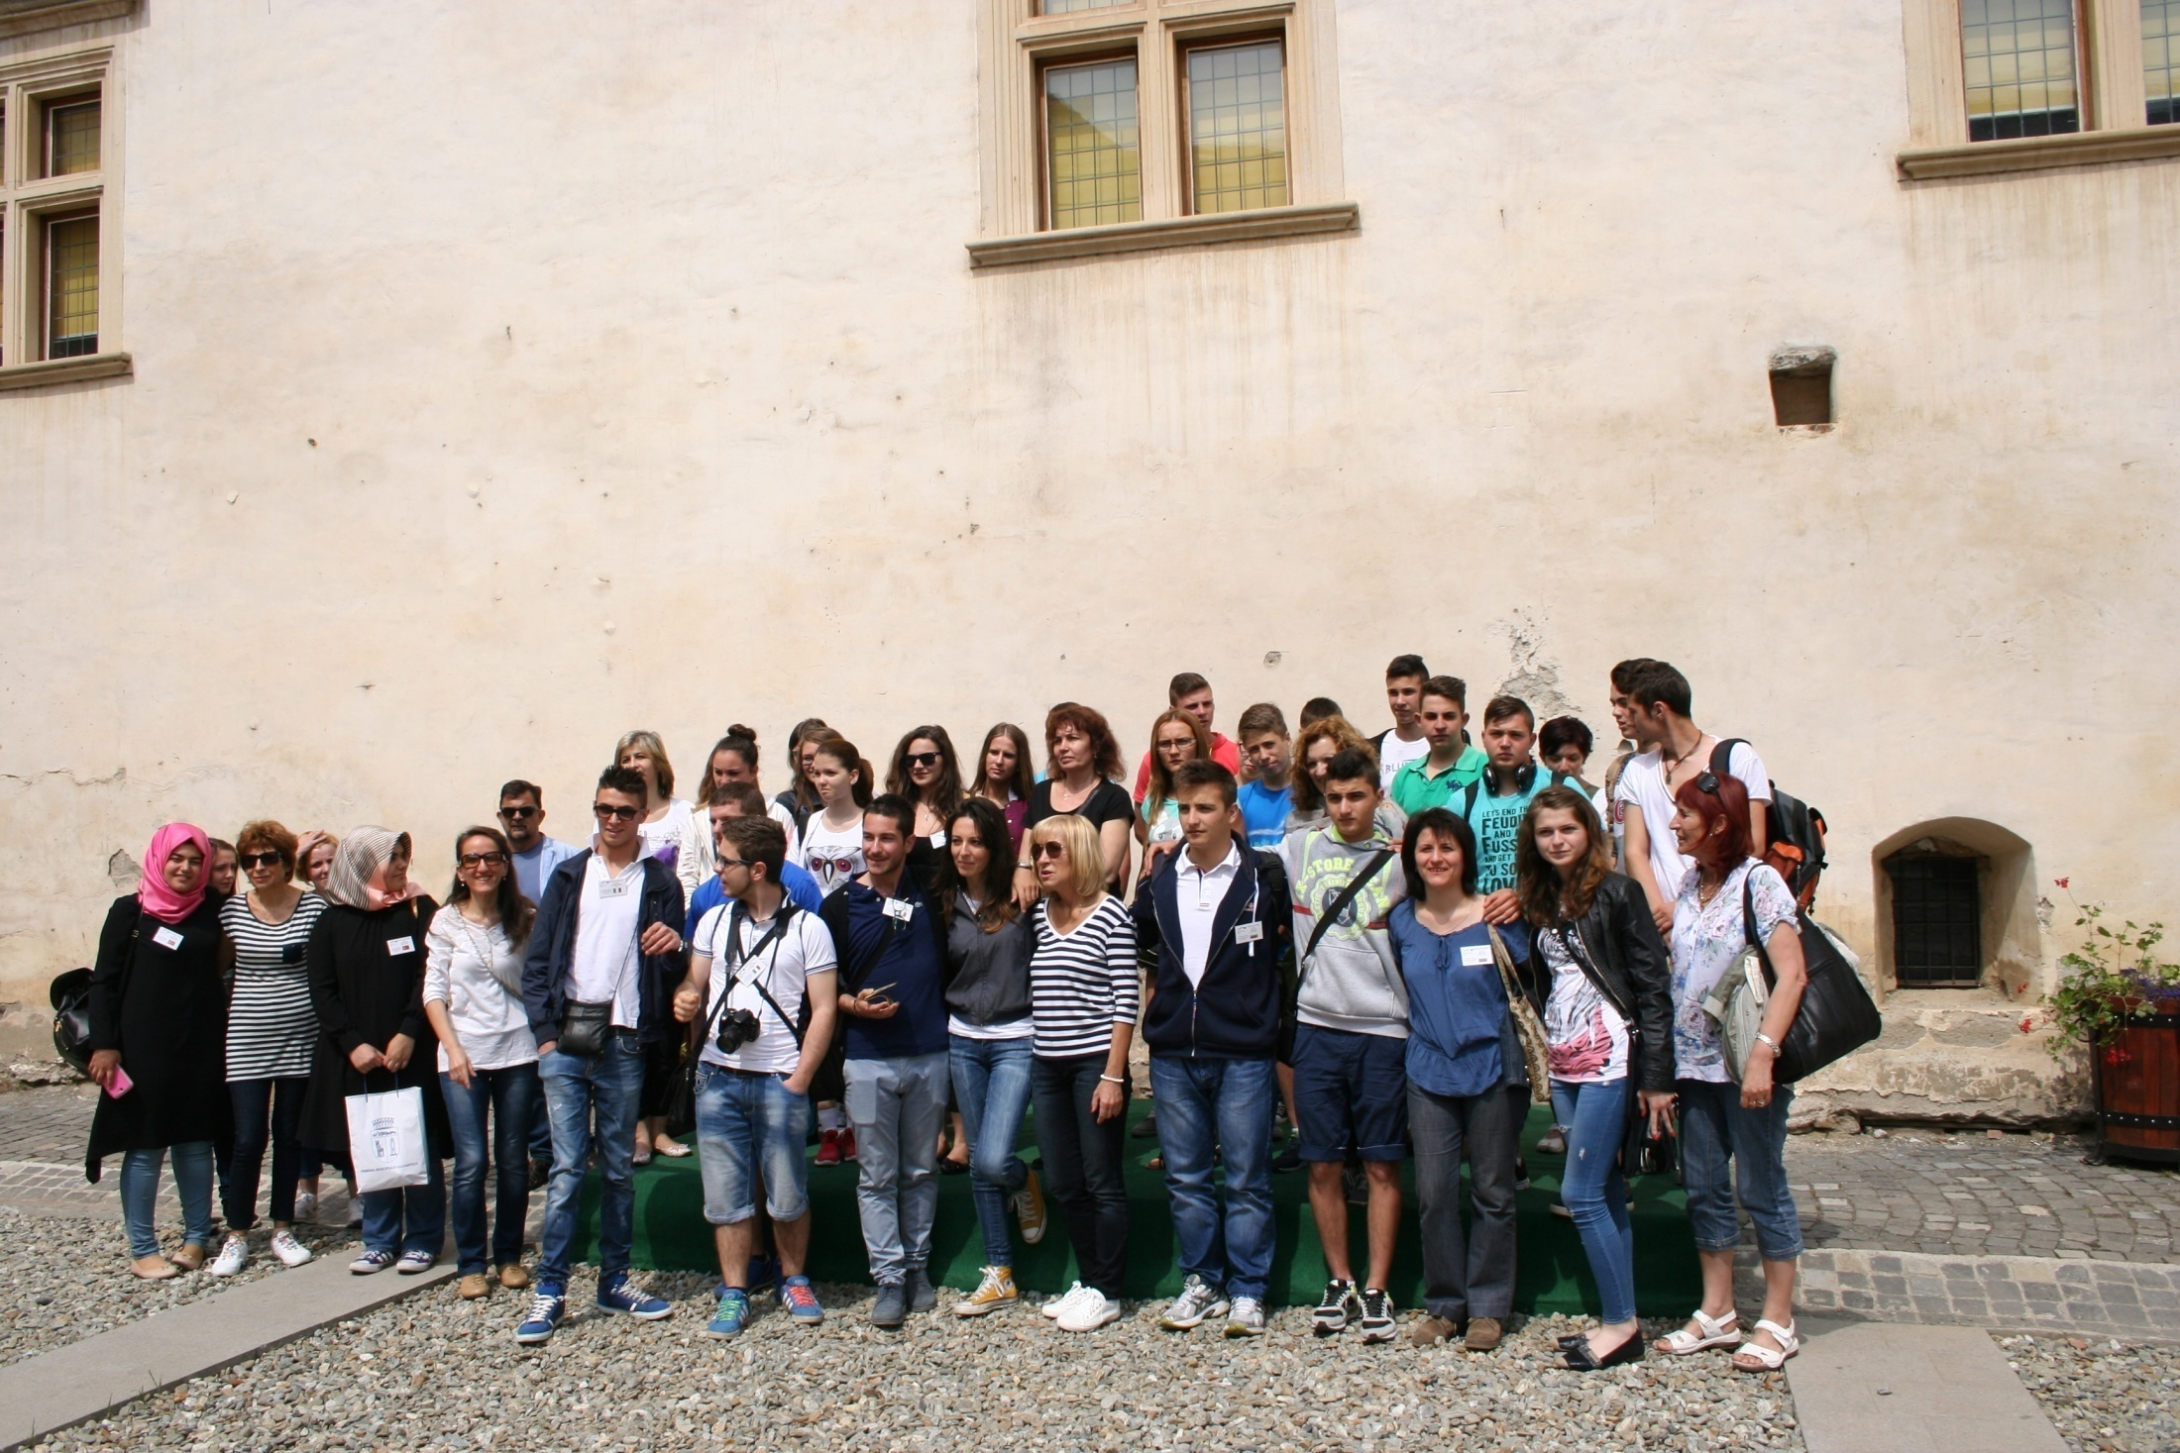

Slide 36
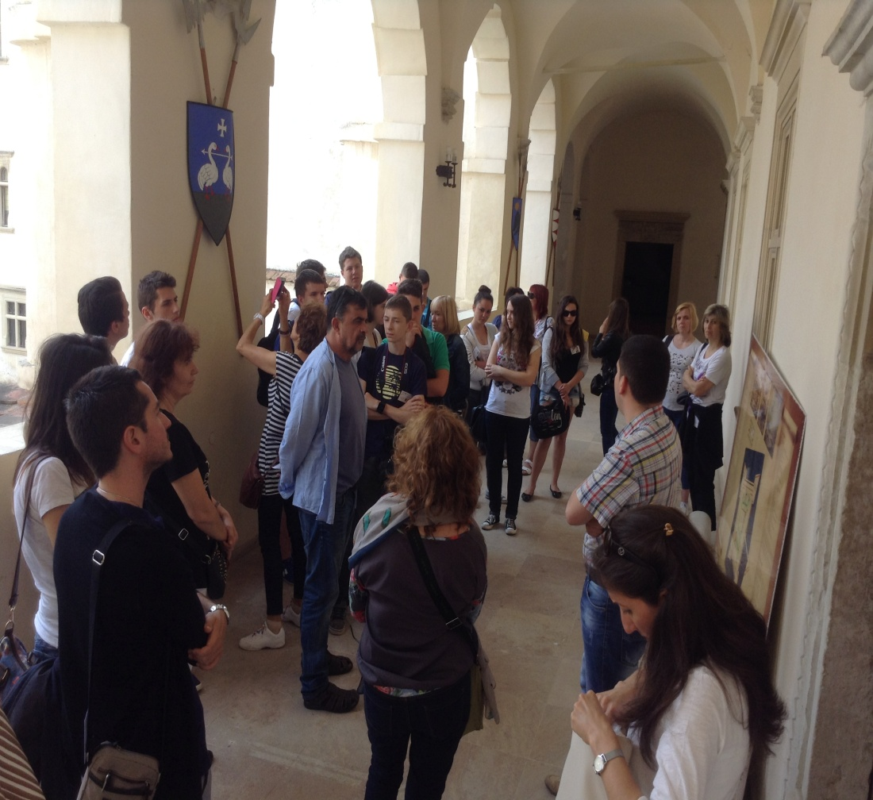
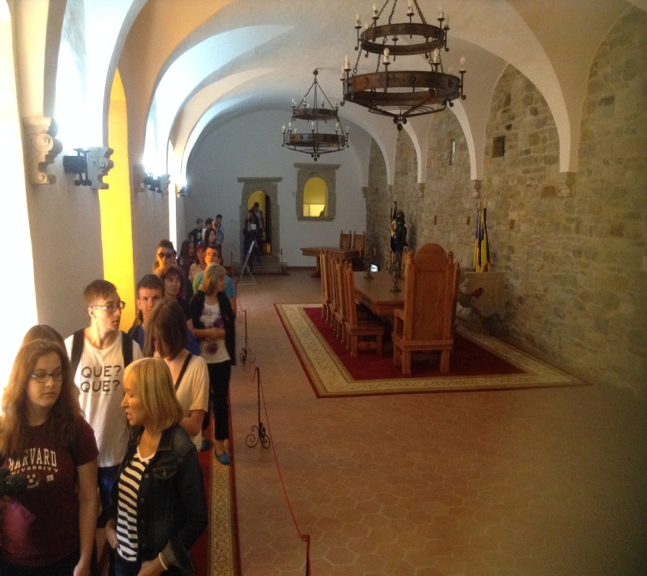
Inside in the castle

Slide 37
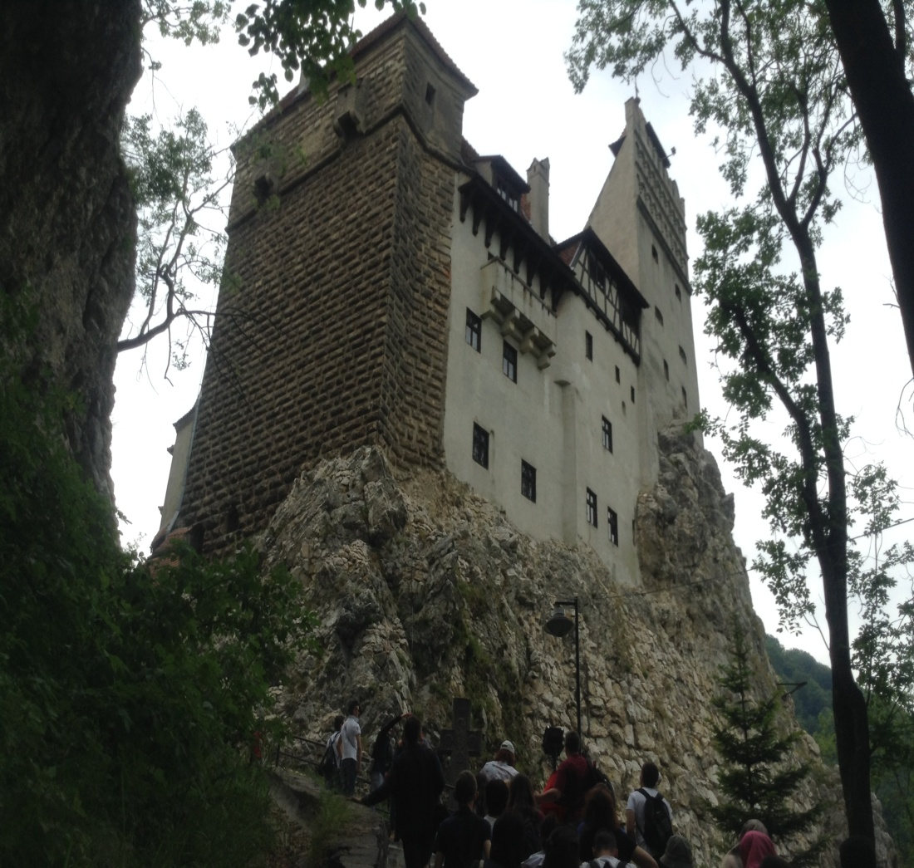
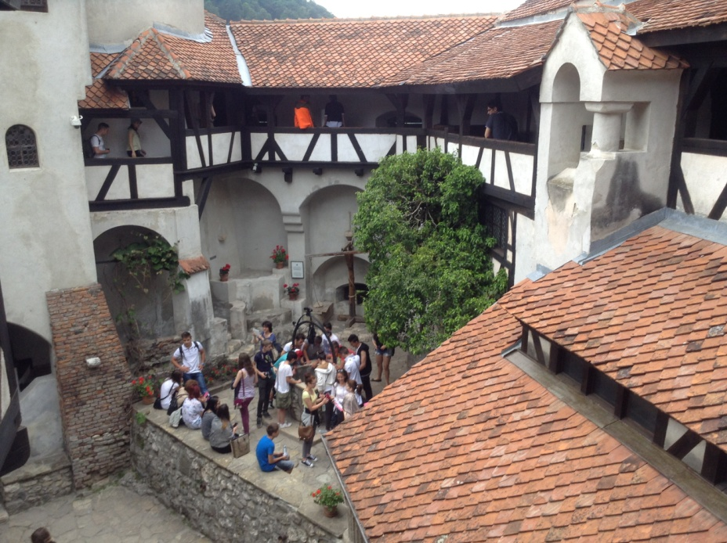
Bran Castle

Slide 38
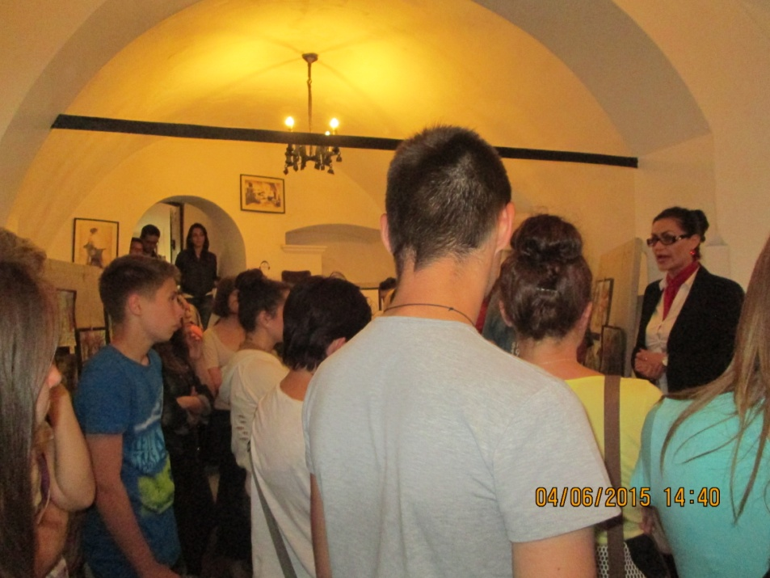
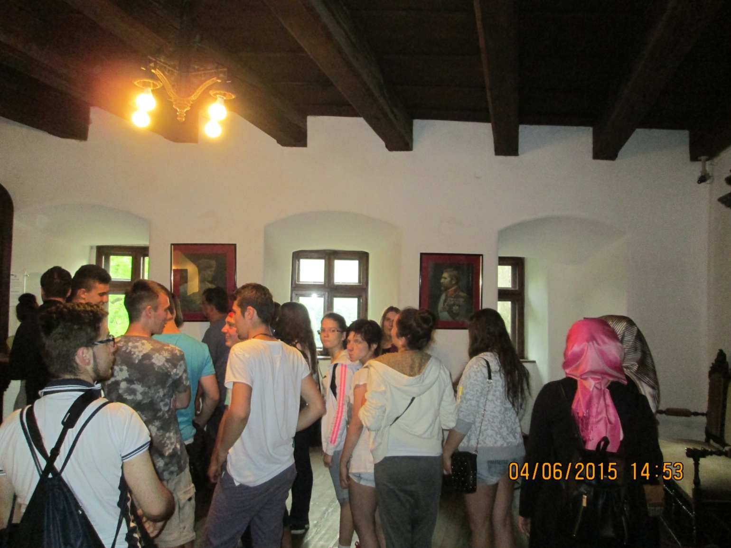
Inside in the castle

Slide 39
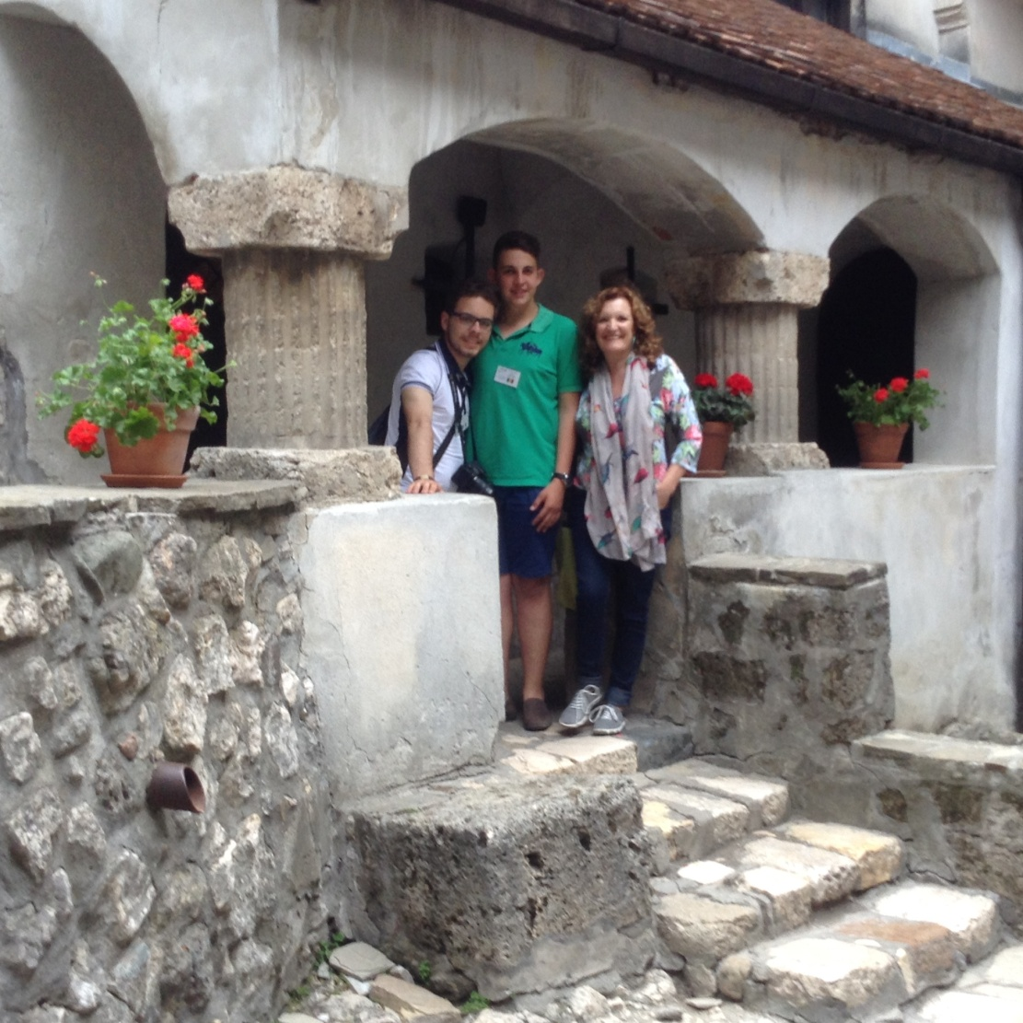
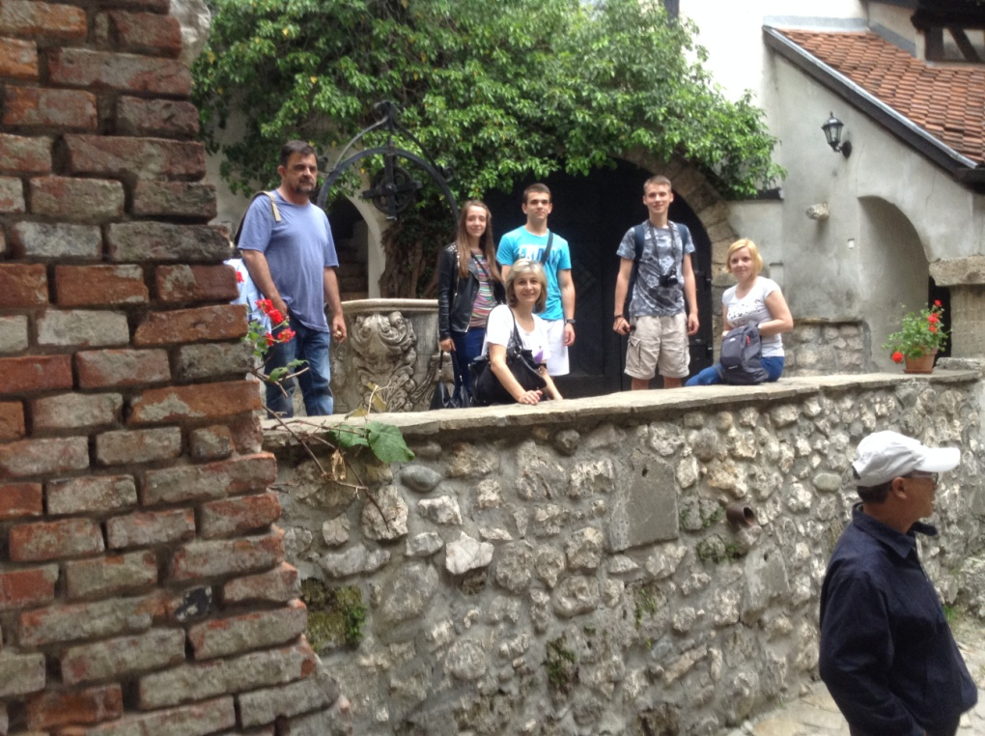
The courtyard

Slide 40
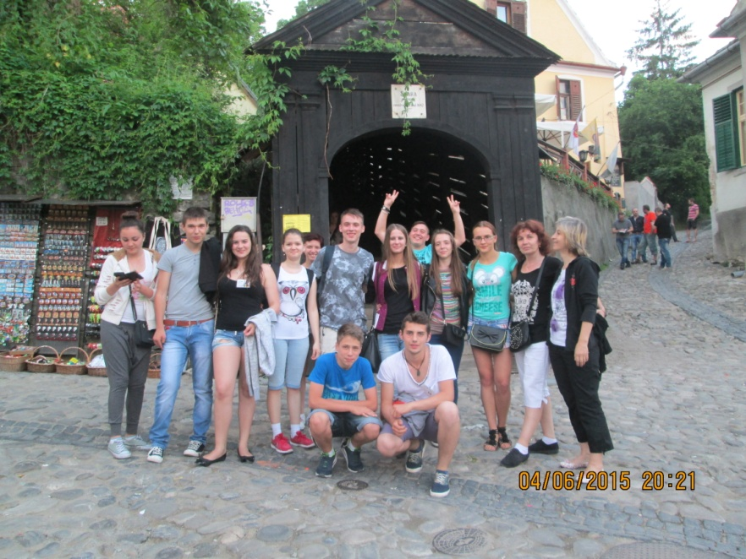
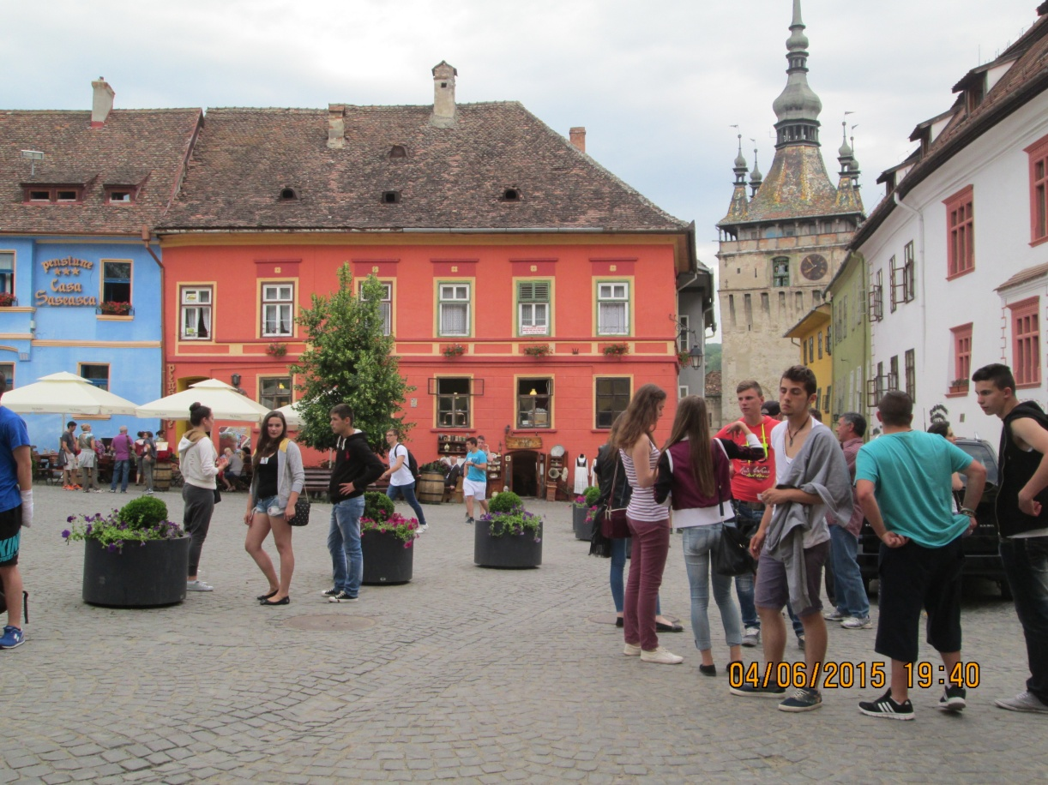
Sighisoara Fortress

Slide 41
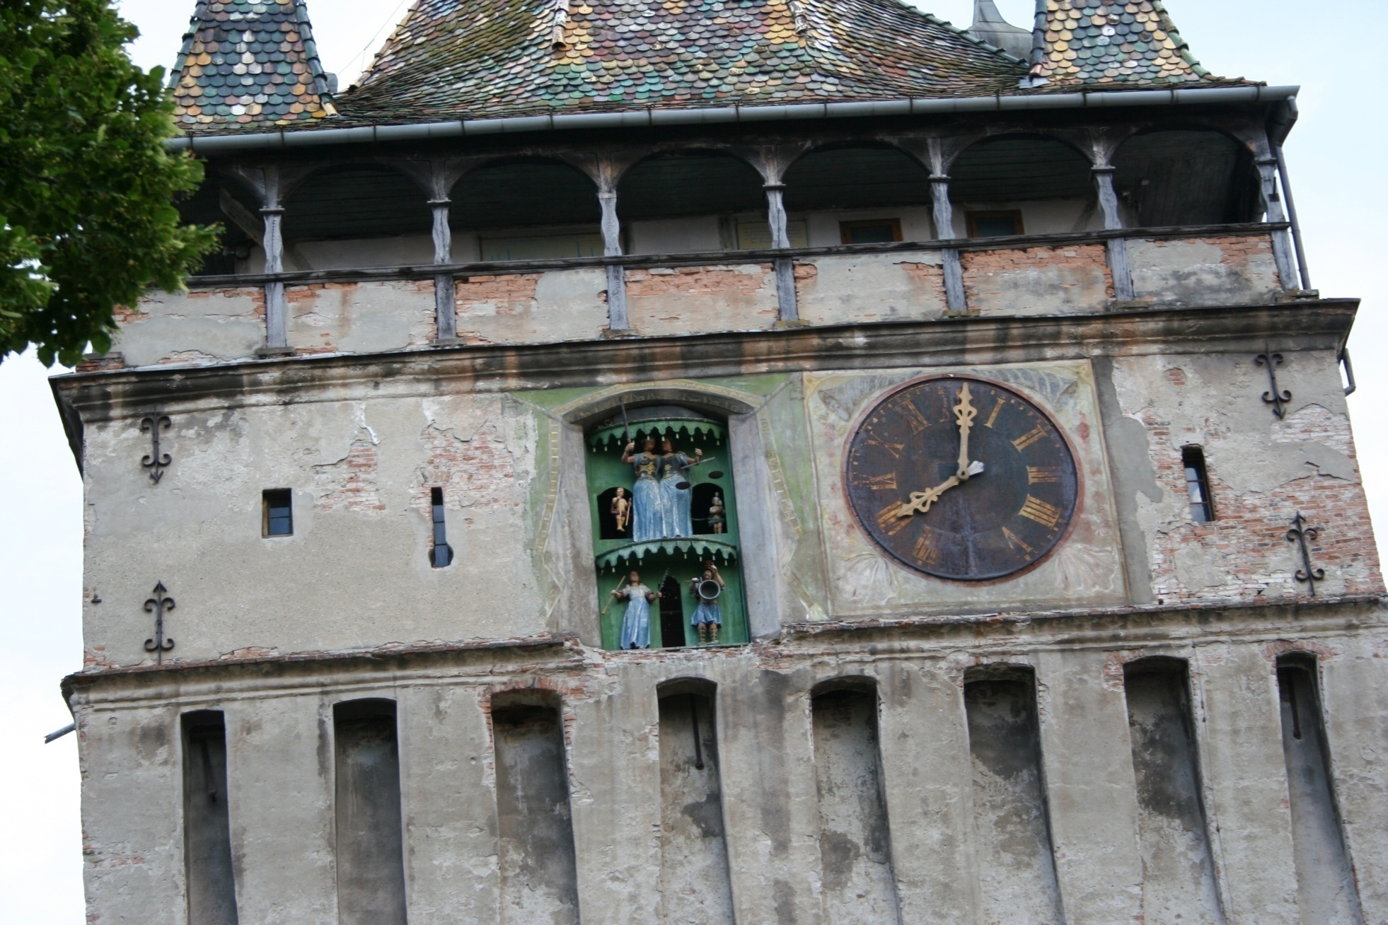
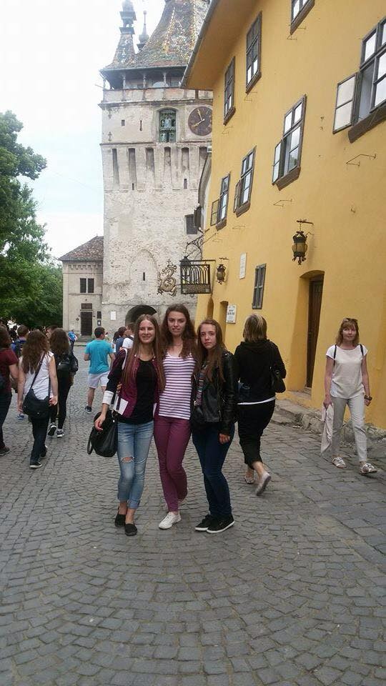
Sighisoara Fortress

Slide 42
5 June - Friday – The wonders of nature and the wonders of science
Study visits
Visit to Turda Salt Mine
Visit to The Etnographic Park “Romulus
Vuia”
The awarding of the certificates

Slide 43
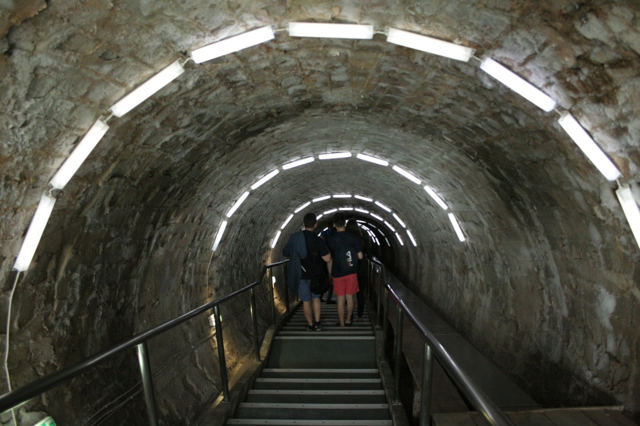
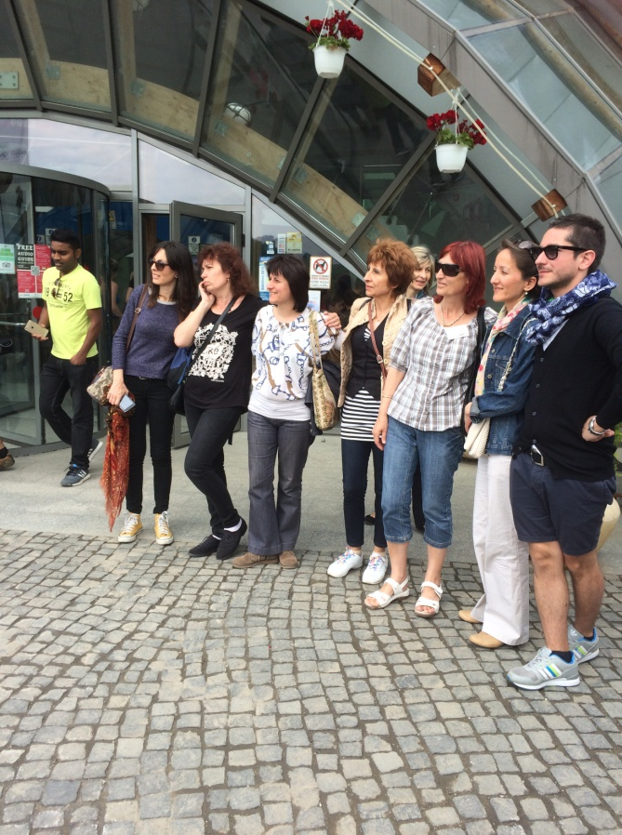
Turda Salt Mine

Slide 44
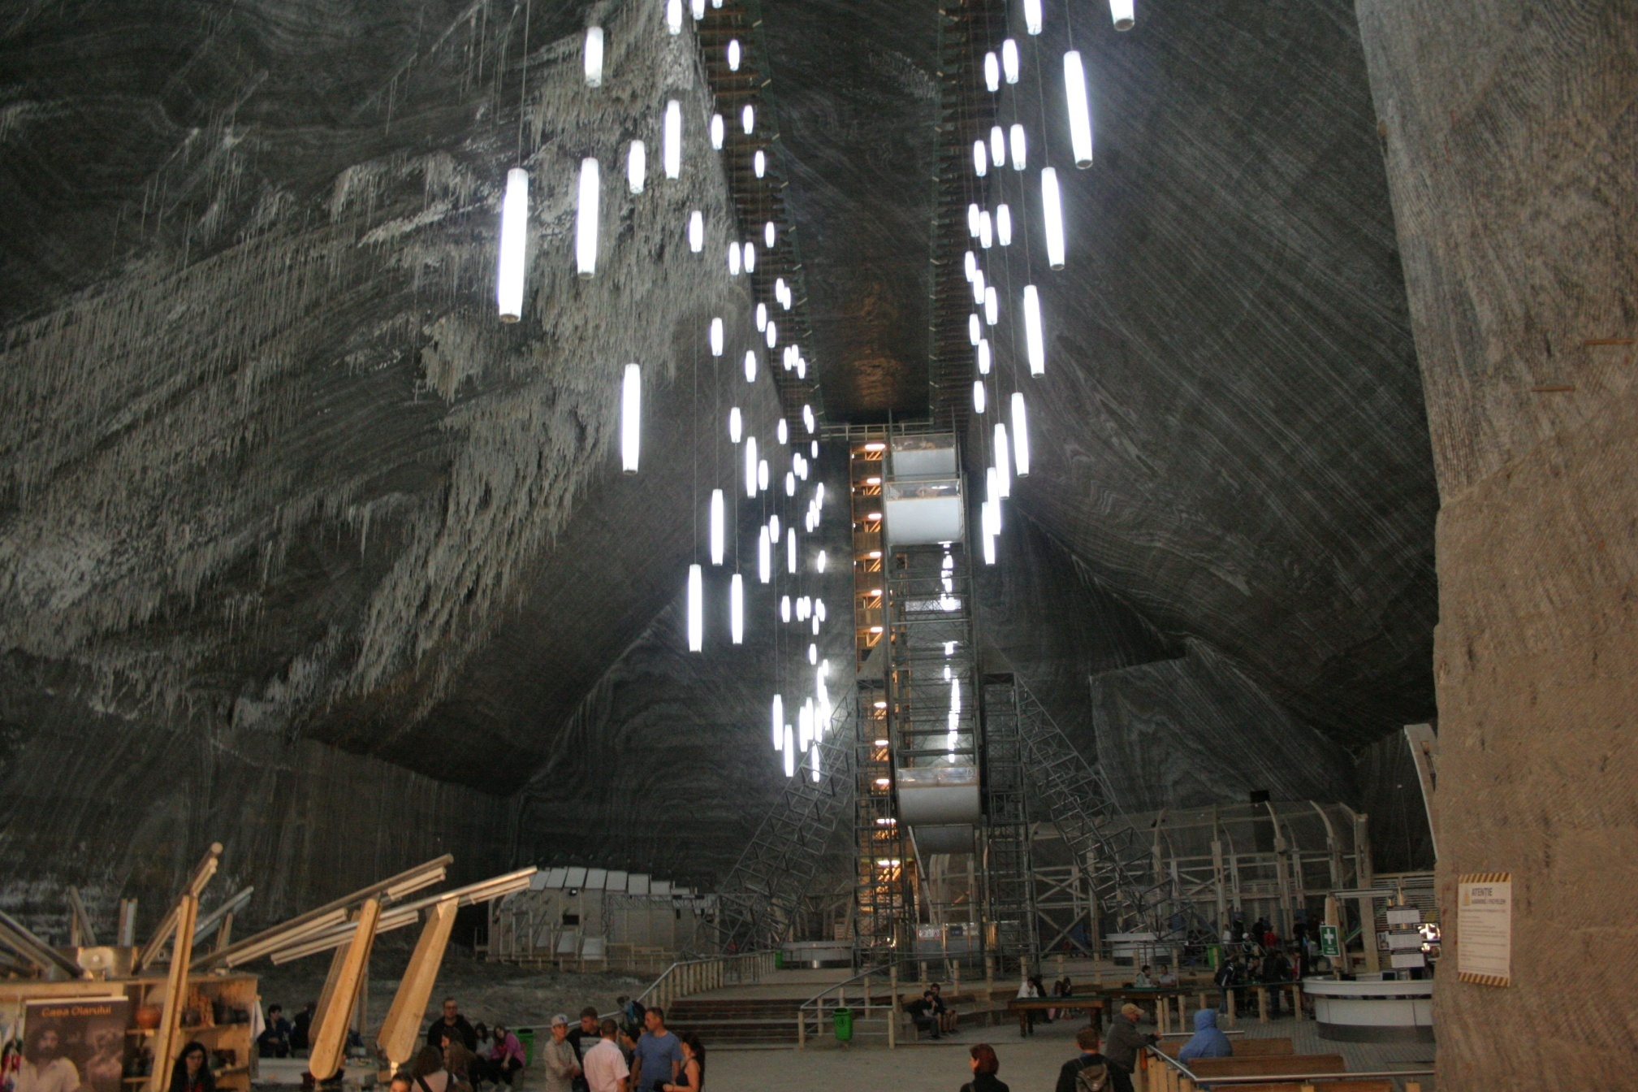
Turda Salt Mine

Slide 45
The Etnographic Park “Romulus Vuia”

Slide 46
The Etnographic Park “Romulus Vuia”

Slide 48
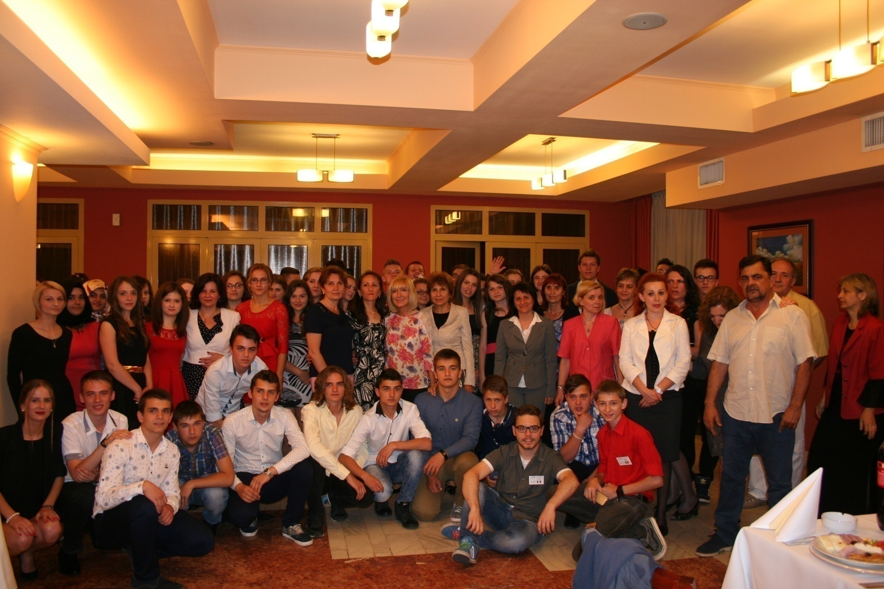
The awarding of the certificates

Slide 49
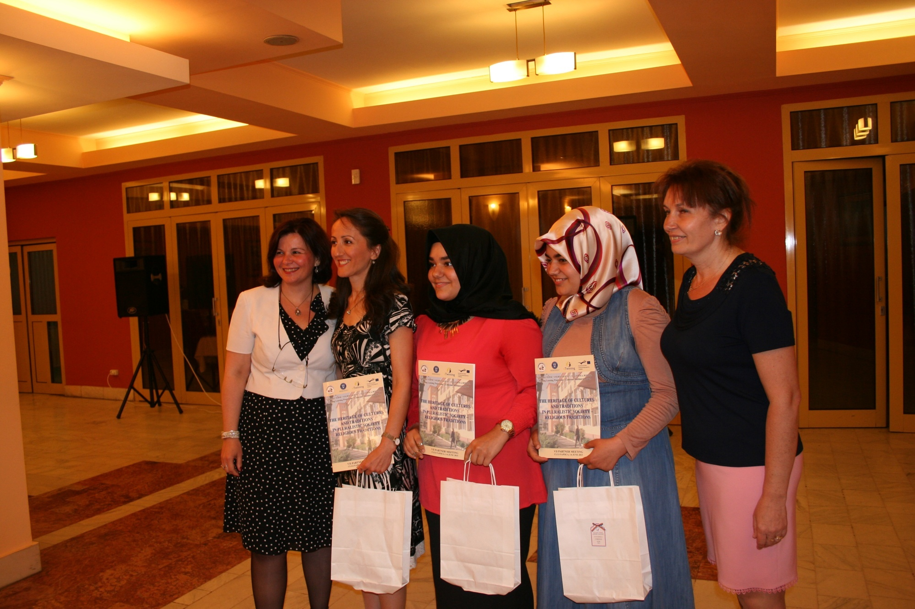
Turkey team

Slide 50
Italian team

Slide 51
Bulgarian team

Slide 52
Polish team

Slide 53
Romanian team

Slide 54
Spanish team
Notes:
Spain Team

Slide 56
Thank you for your attention!
Student Jakab Andrea Brenda
Student Jakab Andrea Brenda

Slide 57
Disclaimer
This project has been funded with support from the
European Commission.
This publication[communication] reflects the views only of
the author and the Commission cannot be held
responsible for any use which may be made of the
information contained therein.
The dissemination was made by the student
Jakab Andrea Brenda

